Slide 1
Models and
Production Models
Notes:
a

Slide 2
Estimation Methods (Overview)
Age
structure
Spatial
structure
Lumped
models
Size
structure
Trophic
interactions

Slide 3
Estimation
(Desired Outputs)
Stock size (spawning biomass, exploitable biomass).
Reference points (B_{MSY}, B₀, 0.2B₀).
  B0 = unfished spawning biomass
Age-, size-structure of the population.

Slide 4
Estimation
(Typical inputs)
Biological parameters:
  Natural mortality, M.
  Growth curve (length-age, weight-length).
  Fecundity.
  Selectivity.
Monitoring data:
  Catch.
  Fishery-dependent (catch-rates; catch-at-age; catch-at-length – by fleet).
  Fishery-independent (survey indices; survey catch-at-age; tagging).

Slide 5
Estimation
(Basic Principles)
Specify a model of the population dynamics (age, sex, size, space, ….), i.e. the equations.
Identify the data that could be used to determine the parameters of the model:
  Data to determine biological parameters (growth, fecundity, etc.) – generally used “outside” the model.
  Data to determine the rest of the parameters – included in the likelihood function.
Construct a likelihood function for the second category of data.
Minimize the negative of the logarithm of the likelihood function (and evaluate fit diagnostics).

Slide 6
Estimation
(Specifying models)
All models have four components:
  Basic dynamics – how do I get from this year to next year?
  Recruitment / growth – how do I balance the impact of losses to natural mortality?
  Catches – how do the catches impact the dynamics of the population?
  Initial conditions – what was the state of the population when my model started?
Note that some of these components (e.g. catches) may be very simple for some models. However, they must all be there somewhere.

Slide 7
Production Models –I
(The basics)
Applicable when:
  No information is available on the biological characteristics of the population (M, growth, etc.)
  All fleets have essentially the same selectivity pattern.

Slide 8
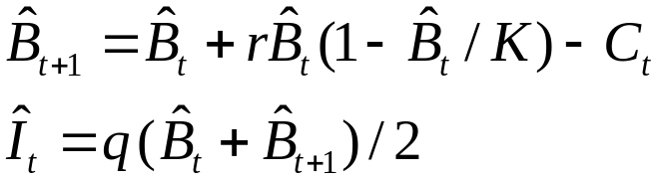
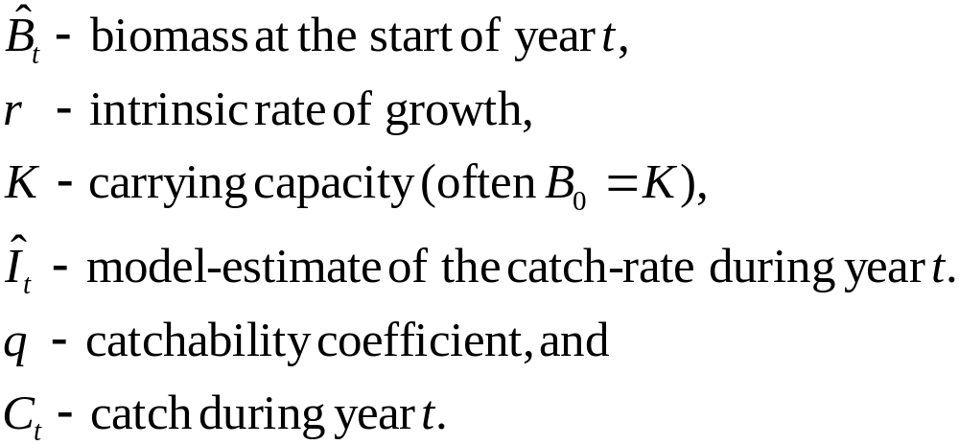
Production Models –II
(The equations)
Shafer equation, max = K/2

Slide 9
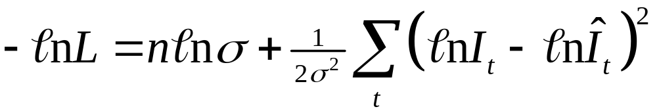
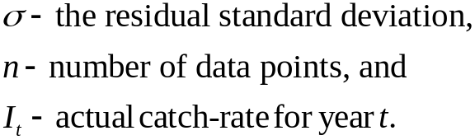
Production Models –III
(The negative log-likelihood)
Relating data to negative log likelihood

Slide 10
Production Models –IV
(Advantages and disadvantages)
Advantages:
  Simple, quick, nice for homework assignments!
  B_{MSY} is calculated easily.
Disadvantages:
  Information on growth, catch-at-length, etc. are usually available for any species for which a reliable index of abundance is available.
  Relies on the assumption that selectivity is the same for all fleets.
  My version ignores process error (but see JABBA).

Slide 11
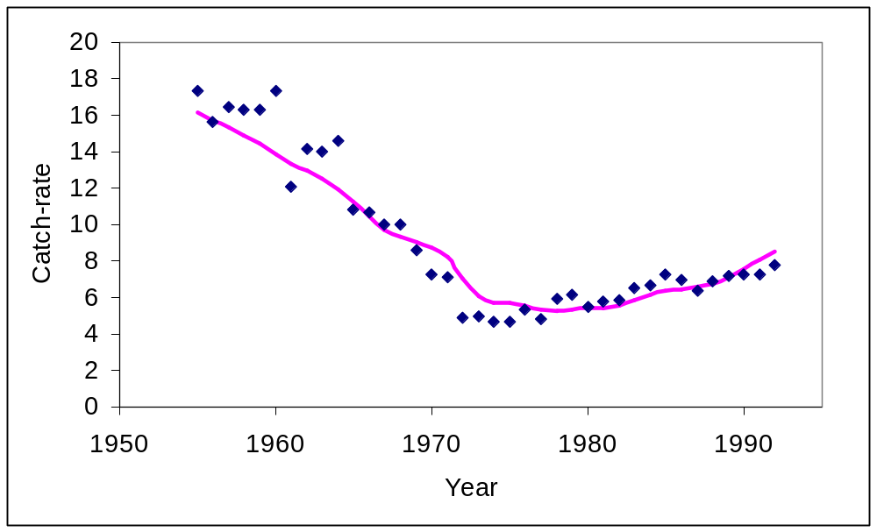
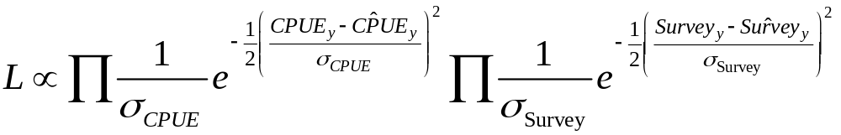
Production Models –V
(Application to Cape Hake)
Two indices of abundance (catch-rates and surveys). The likelihood function is therefore:

Slide 12
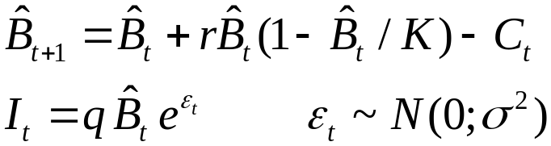
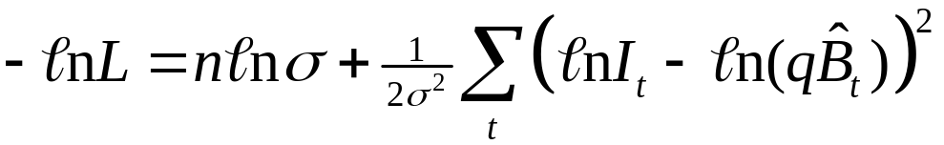
Exercise-I
The aim of this exercise is to fit a production model to the catch and effort data for South Pacific albacore
We will assume that B₁₉₆₇=K, so this model has four estimable parameters (r, K, q, σ). The negative log-likelihood is given by:

Slide 13


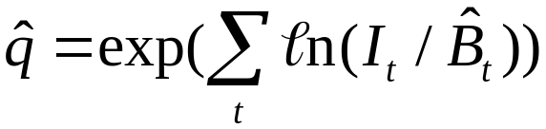
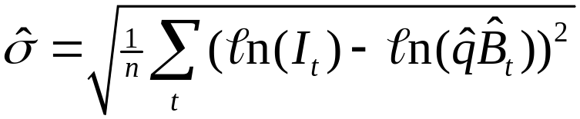
Exercise-II
We could estimate all four parameters using mle but it is possible to reduce the number of parameters in the mle search from two to four by finding analytical solutions for q and σ by solving:
The solutions are:

Slide 14

Exercise-III
Substituting the maximum likelihood estimates for q and σ into the negative log-likelihood function leads to the concentrated likelihood:

Slide 15
Exercise-IV
The tasks for the in-class part of this exercise are to:
fit the model to the data to estimate r and K and the biomass trajectory; and
plot the fit of the model to the data to examine whether it is adequate.
The tasks for the homework component of this exercise are:
reformulate the model so MSY and r are parameters and not K and r and the check the estimated biomass trajectory is the same (or very close) for the original and reformulated models; and
use likelihood profile to find a 95% confidence interval for MSY.

